Slide 1

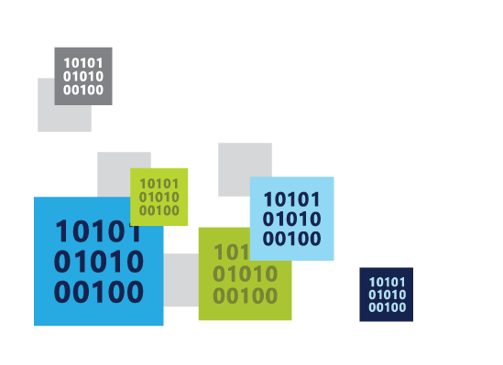

Going Offline with Android and Azure
Chris Risner
Senior Technical Evangelist
@ChrisRisner
http://chrisrisner.com
Notes:
Slide 4: (Title Slide)
<< Note: Be sure to welcome and thank the audience, introduce yourself and your role before you get started with presentation>>
Welcome – today we’re going to be talking about something you may either just be starting to implement in your enterprise, or further along than most, and that’s how investing in apps is keeping all types of enterprises relevant to their customers.
You’re going to learn about some companies—old and new—who are doing some exciting things on that front.
I’m also going to talk to you about leveraging your existing infrastructure investments to build bridges between you and your customers.
And finally, we’re go over some examples of how this is being done today with some of the case studies we’re really proud of.
But first, it’s important to see app innovation as not just a standalone strategy or a set of services that work independently.
Instead, we need to see app innovation and development as part of a larger story that we at Microsoft are telling, and that story is about a complete, comprehensive cloud strategy that entails every aspect of your business and digital investment– of which app strategy is just one major part.

Slide 2



About Me

Slide 3
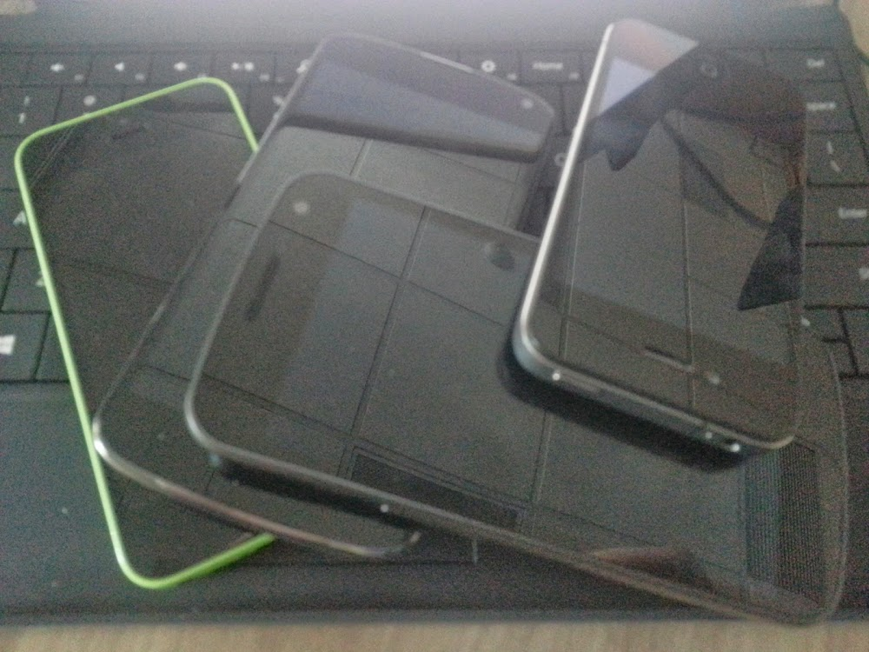
Agenda
Azure Overview
Going Offline
Dealing with Conflicts
Q & A

Slide 4
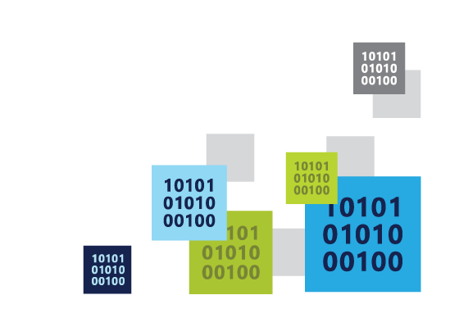
Azure Overview
a cloud for everyone

Slide 5
Why the cloud?
Hosting models
Business model
On Premises
Infrastructure
(as a Service)
Platform
(as a Service)
Software
(as a Service)
Applications
Applications
You manage
Applications
Applications
Data
You scale, make
resilient & manage
Data
Data
Data
You scale, make resilient and manage
Runtime
Runtime
Runtime
Runtime
Scale, resilience and management by vendor
Middleware
Middleware
Middleware
Middleware
Scale, resilience and management by vendor
O/S
O/S
O/S
O/S
Virtualization
Virtualization
Managed by vendor
Virtualization
Virtualization
Servers
Servers
Servers
Servers
Storage
Storage
Storage
Storage
Networking
Networking
Networking
Networking

Slide 6
17 regions worldwide in 2015
Azure footprint
Data Centers
Regional Partners
Notes:
Speaker notes:
Broad global reach
Azure maintains a global presence across 17 datacenter around the world to help customers and partners meet their goal of providing applications close to their user base.
Mention contribution of regional partners help Azure’s global presence.
Microsoft's continued investment in subsea and terrestrial dark fiber capacity helping deliver data at higher speeds, with higher capacity and lower latency for our customers across the globe.
Use the following notes if you want to address some or all security, compliance, transparency and privacy concerns of the audience.
Microsoft has leveraged its decades-long experience in operating some of the world’s largest online services to create a robust set of security technologies and practices to keep your data at rest or in motion secured in Azure.
Azure meets a broad set of international and industry-specific compliance standards as part of help customer attain compliance for their own infrastructure running on the platform.
Azure is subjected to rigorous audits by independent organizations and the results are available to you as a part of Microsoft's commitment to transparency.
Azure adheres to stringent privacy policies through a program called Privacy by Design which describes Microsoft's core privacy concerns to protect customer data and how to address them. Those protections are then backed with strong contractual commitments to safeguard customer data with by abiding by the EU Model Clauses, Safe Harbor programs, and ISO/IEC 27018 (which governs the processing of personal information).

Slide 7







Microsoft Azure Services
Office Add-in
PC
Tablet
Phone
Browser
Games console
On-premises service
On-premises database
Client layer
(on-premises)
Access Control
Layer
AD
Multifactor
Authentication
BizTalk Services
Service Bus
Logic Apps
Traffic Manager
Virtual Networks
Express Route
CDN
Integration
layer
API Mgmt
Mobile Apps
Web Apps
API Apps
VM
Media Services
Notification Hubs
Scheduler
Automation
Cloud Services
Application
layer
Blobs
Tables
Queues
SQL Database
Machine Learning
HD Insight
Caching
Backup and Recovery
StorSimple
Data Layer
Storage
Data

Slide 8



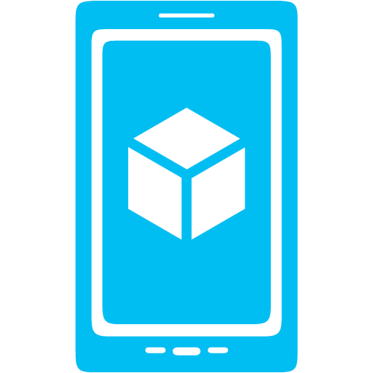



Azure App Service Mobile Apps
Provides essential services to support client development
Client Support
Android
iOS
HTML5/Web
Xamarin
Windows
Windows Phone
PhoneGap
Sencha
Storage
Authentication
Logic
Push
Scheduler
Notes:
Speaking Notes
Azure Mobile Services is a Backend-as-a-Service
Instead of you having to design, build, test, deploy, manage, and upgrade your whole backend, we do it for you
Features of Mobile Services
Storage – SQL DB
Authentication – built in support for social providers w/ ability to custom auth
Backend logic – data validation, logical flows, etc
Push Notifications – across all major mobile platforms
Scheduler – backend job processing

Slide 9
Demo: Azure Mobile Services
Notes:
In this demo we should create a mobile service, download the Android client, run the app, walk through the code, then take the emulator offline and show that it doesn’t work

Slide 10
Going Offline
the internets are down!

Slide 11
Demo: Breaking the App
Notes:
Go offline, show that the app doesn’t work

Slide 12

Slides explaining complexities of going offline
Many consider
A slide showing possible options for dealing with offline
Don’t worry about it (assume they’re connected)
Store data in a local store (i.e. SQLite) but don’t allow updating
Store all data changes locally and sync with server when reconnected

Slide 13
Demo: Taking the App Offline
Notes:
Add offline support including sync button. Reinstall app on device, go offline, save some data, go to portal, show data isn’t there, take device back online,sync data. Show portal again

Slide 14
Dealing with Conflicts
let’s find a resolution

Slide 15
Why is offline Important?
Cellular signals aren’t everywhere
Wi-Fi isn’t everywhere
Signal performance can be poor
Apps should work regardless
Downgrade the experience, but provide one

Slide 16
How does it work?
SyncTables are used
Locally store queue of CRUD operations
No-automatic syncing with server
Conflicts detected and handled on client or server
Backed by SQLite DB

Slide 17


Conflicts and Optimistic Concurrency
Device 1
Server
Device 2
Create
▲, 1
▲, 1
▲, 1
Fetch
▲, 1
▲, 1
▲, 1
Update
▲, 1
■, 2
▲, 1
■, 2
Update
✘
▲, 1
●, 2
■, 2
■, 2

Slide 18
Caveats and Sidenotes
Primarily for occasionally-connected and primary online scenarios
Backend agnostic (.NET and Node.JS)
Works with SQL and Azure Tables, and Mongo, etc
Supports all the same client platforms

Slide 19
Demo: Conflict Resolution
Notes:
Prior to adding any sort of conflict handling, consider actually causing a conflict by:
Run app on two emulators, have data on both, take one app offline, change data in the one that’s still online, then go back and change data on offline one, reconnect, trigger sync

Slide 20
Patterns for Sync
Manual sync isn’t ideal
Automation can often be better
Check with ConnectivityManager
Or Register a BroadcastReceiver for Connectivity Changes
Sync data (if it’s the right kind of connectivity)
WiFi vs Mobile

Slide 21
Other Azure Services for Android devs
Azure Notification Hubs
Azure Storage Library
Azure Active Directory Authentication Library (ADAL)
Office 365 / SharePoint SDKs
Visual Studio Online
Hybrid Connections
Azure Remote App
Azure Media Services

Slide 22
More Resources
Offline + Android Tutorial
http://aka.ms/AndroidOffline
Android and Azure Resources
http://azure.microsoft.com/android
Contact me
@ChrisRisner
http://chrisrisner.com

Slide 23

eventmobi.com/adcboston
Please take a moment to fill out the class feedback form via the app. Paper feedback forms are also available in the back of the room.

